Slide 1
Apache spark fast engine for large data
Dr. Emmanuel S. Pilli
Malaviya NIT Jaipur

Slide 2
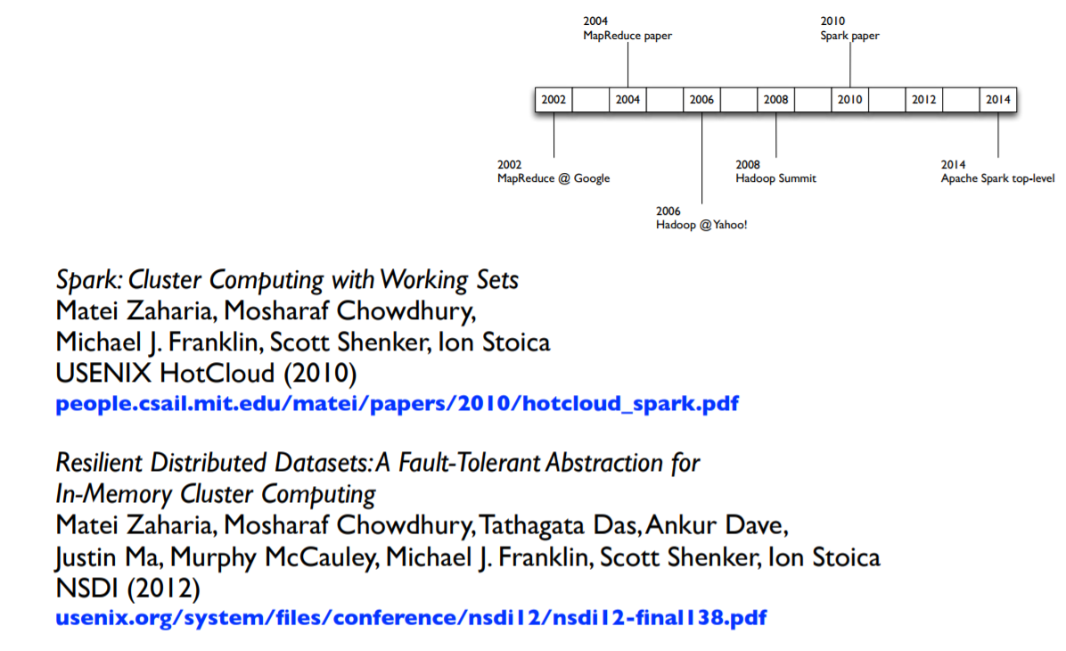
History- Spark

Slide 3
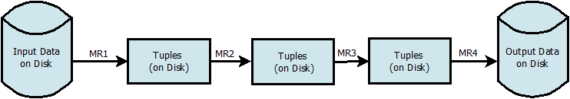
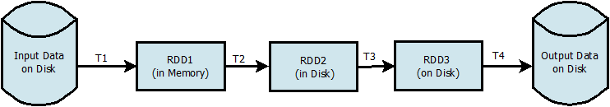
Need of Spark
Machine learning algorithms are iterative in nature.
To perform iterations earlier tools uses the concept of Disk writing i.e. intermediate result is written to disk after each iteration. Making it slow.
Hadoop Work Flow
Spark Work Flow

Slide 4


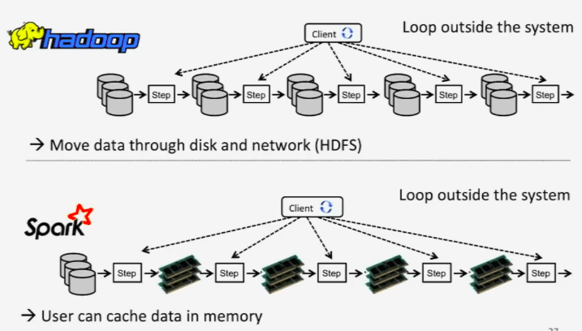

Slide 5
Apache Spark
Apache Spark is a lightning-fast cluster computing technology, designed for fast computation.
It is based on Hadoop MapReduce and it extends the MapReduce model to efficiently use it for more types of computations, which includes interactive queries and stream processing.
The main feature of Spark is its in-memory cluster computing that increases the processing speed of an application.
Spark is designed to cover a wide range of workloads such as batch applications, iterative algorithms, interactive queries and streaming.
Apart from supporting all these workload in a respective system, it reduces the management burden of maintaining separate tools.

Slide 6
Spark Features
Speed − Spark helps to run an application in Hadoop cluster, up to 100 times faster in memory, and 10 times faster when running on disk. This is possible by reducing number of read/write operations to disk. It stores the intermediate processing data in memory.
Supports multiple languages − Spark provides built-in APIs in Java, Scala, or Python. Therefore, you can write applications in different languages. Spark comes up with 80 high-level operators for interactive querying.
Advanced Analytics − Spark not only supports ‘Map’ and ‘reduce’. It also supports SQL queries, Streaming data, Machine learning (ML), and Graph algorithms.

Slide 7
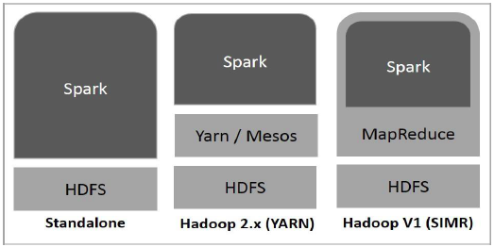
Spark and Hadoop

Slide 8
Apache Spark
MapReduce is built around an acyclic data flow model which is not suitable for popular apps
Applications that reuse a working set of data across multiple parallel operations
Spark introduces an abstraction called Resilient Distributed Datasets (RDDs)
An RDD is a read only collection of objects partitioned across a set of machines that can be rebuilt if a partition is lost.
Spark is implemented in a functional programming language, Scala and outperforms Hadoop by 10x.

Slide 9
Resilient Distributed Datasets (RDDs)
A distributed memory abstraction that lets programmers perform in memory computations on large clusters in a fault tolerant manner.
RDDs provide a restricted form of shared memory based on a coarse-grained transformations rather than fine-grained updates to shared space.
RDDs are expressive enough to capture a wide class of computations

Slide 10
Resilient Distributed Datasets (RDDs)
Main challenge in designing RDDs is defining a programming interface that can provide fault tolerance efficiently
RDDs provide an interface based on coarse-grained transformations (map, filer and join) that apply the same operation to many data items
RDDs are good fit for many parallel applications

Slide 11
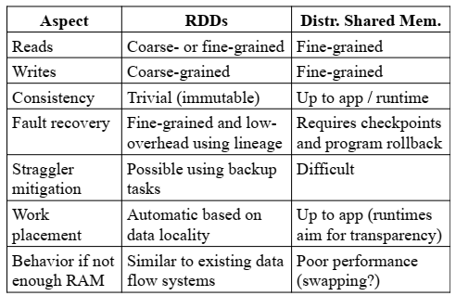
RDD vs Shared Memory

Slide 12

Apache Spark
Two reasonable small additions in Spark
Fast Data Sharing
General DAGs
By incorporating these changes Spark becomes:
More efficient for engine.
Much simpler for end users.

Slide 13

Apache Spark
Fast and general engine for large scale data processing.
Developed in 2009 at UC Berkley AMPLabs.
Open sourced in 2010.
Now among one of the largest community with 400+ contributors from 100 + industries

Slide 14
Spark Smashing Earlier Record
 | Hadoop MR Record | Spark Record | Spark 1 PB
Data Size | 102.5 TB | 100 TB | 1000 TB
Elapsed Time | 72 mins | 23 mins | 234 mins
# Nodes | 2100 | 206 | 190
# Cores | 50400 physical | 6592 virtualized | 6080 virtualized
Cluster disk throughput | 3150 GB/s (est.) | 618 GB/s | 570 GB/s
Sort Benchmark Daytona Rules | Yes | Yes | No
Network | dedicated data center, 10Gbps | virtualized (EC2) 10Gbps network | virtualized (EC2) 10Gbps network
Sort rate | 1.42 TB/min | 4.27 TB/min | 4.27 TB/min
Sort rate/node | 0.67 GB/min | 20.7 GB/min | 22.5 GB/min

Slide 15
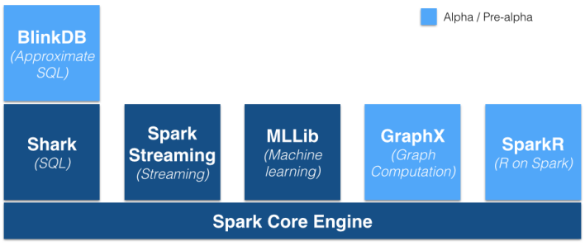
Apache Spark Ecosystem

Slide 16
Apache Spark Ecosystem
BlinkDB
massively parallel, approximate query engine for running interactive SQL queries on large volumes of data.
Spark SQL
module for working with structured data.
Spark Streaming
easy to build scalable fault-tolerant streaming applns.
MLlib
scalable machine learning library.
GraphX
API for graphs and graph-parallel computation.

Slide 17

Spark: Word Count Code
Scala
val f = sc.textFile("README.md")
val wc = f.flatMap(l => l.split(" ")).map(word => (word, 1)).reduceByKey(_ + _)
wc.saveAsTextFile("wc_out")
Python
from operator import add
f = sc.textFile("README.md")
wc = f.flatMap(lambda x: x.split(' ')).map(lambda x: (x,1)).reduceByKey(add)
wc.saveAsTextFile("wc_out")
Path of input file
Path of ouput
file
Split file into words
Store word (X,1)
Take all unique
Words and count

Slide 18
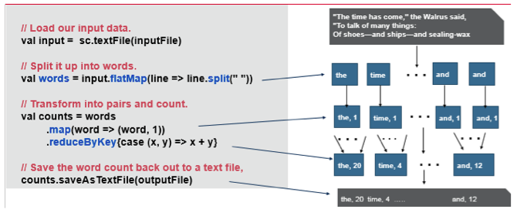
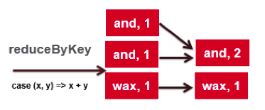
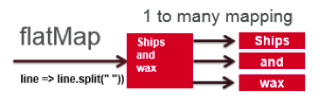
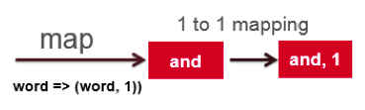
Example

Slide 19
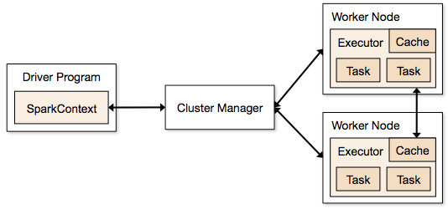
Apache Spark Essentials
Spark Context
Initially every spark program creates a Spark Context. Which tells spark how to access a cluster
Clusters
master connects to a cluster manager to allocate resources across applications
acquires executors on cluster nodes – processes run compute tasks, cache data
sends app code to the executors
sends tasks for the executors to run

Slide 20
Apache Spark Essentials
Resilient Data Distribution
Primary abstraction in Spark
a fault-tolerant collection of elements that can be operated on in parallel
RDD can be computed by two ways
Spark Standalone mode:
parallelized collections – take an existing Scala collection and run functions on it in parallel.
Spark using Hadoop HDFS:
run functions on each record of a file in Hadoop distributed file system

Slide 21
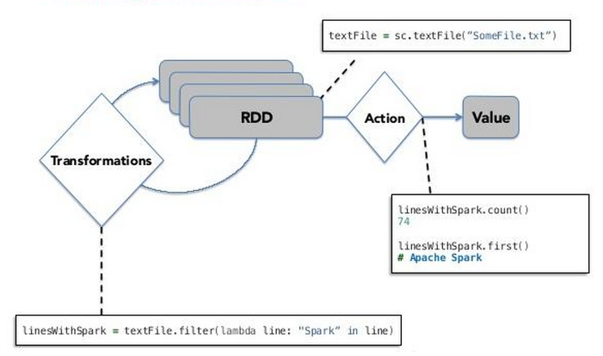
RDD Working

Slide 22
RDD Working
Two types of operation on RDD
Transformation
Function similar to map or filter.
Create a new dataset from existing one.
Performs lazy evaluations.
Action.
It performs the actual operation such as count () function in word count and write back the results to storage.
Spark can persist (or cache) a dataset in memory across operations.
Each node stores in memory any slices of it that it computes and reuses them in other actions.
often making future actions more than 10x faster

Slide 23
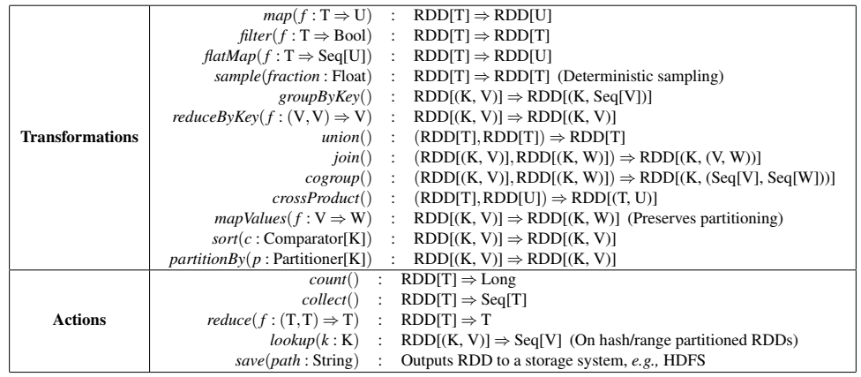
Transformations and Actions

Slide 24
Spark vs Mapreduce
Features | Spark | Mapreduce
Speed | 100x faster in memory and 10x faster on disk than Mapreduce | reads and writes from disk, as a result, it slows down the processing speed
Difficulty | easy to program as it has tons of high-level operators with RDD | developers need to hand code each and every operation which makes it very difficult to work
Easy to Manage | Spark is capable of performing batch, interactive and Machine Learning and Streaming all in the same cluster. As a result makes it a complete data analytics engine. So no need to manage different component for each need. | As MapReduce only provides the batch engine. Hence, we are dependent on different engines. For example- Storm, Giraph, Impala, etc. for other requirements. So, it is very difficult to manage many components.
Real-time Analysis | can process real time data i.e. data coming from the real-time event streams at the rate of millions of events per second, | MapReduce fails when it comes to real-time data processing as it was designed to perform batch processing on voluminous amounts of data.
Latency | Spark provides low-latency computing. | MapReduce doesn’t have an interactive mode.
Interactive mode | Spark can process data interactively. | MapReduce doesn’t have an interactive mode.
Streaming | Spark can process real time data through Spark Streaming. | With MapReduce, you can only process data in batch mode.

Slide 25
Continue..
Features | Apache Spark | MapReduce
Security | Spark is little less secure in comparison to MapReduce because it supports the only authentication through shared secret password | More secure because of Kerberos and it also supports Access Control Lists (ACLs) which are a traditional file permission model.
Language Developed | developed in Scala. | developed in Java.
Cost | Spark requires a lot of RAM to run in-memory. Thus, increases the cluster, and also its cost. | MapReduce is a cheaper option available while comparing it in terms of cost.
Programming Language support | Scala, Java, Python, R, SQL. | Primarily Java, other languages like C, C++, Ruby, Groovy, Perl, Python are also supported using Hadoop streaming.
SQL support | enables the user to run SQL queries using Spark SQL. | enables the user to run SQL queries using Apache Hive
The line of code | Apache Spark is developed in merely 20000 line of codes. | Hadoop 2.0 has 1,20,000 line of codes
Machine Learning | Spark has its own set of machine learning ie MLlib. | Hadoop requires machine learning tool for example Apache Mahout.
Caching | Spark can cache data in memory for further iterations. As a result it enhances the system performance. | MapReduce cannot cache the data in memory for future requirements. So, the processing speed is not that high as that of Spark.

Slide 26
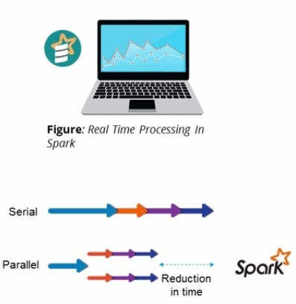
What is Apache Spark ?
Apache Spark is an Open Source Cluster Computing Framework for Real Time Processing Developed by Apache Spark Foundation
Spark provides Data Parallelism & Fault Tolerance
Spark was build on top of Hadoop MapReduce & it extends MapReduce Model

Slide 27
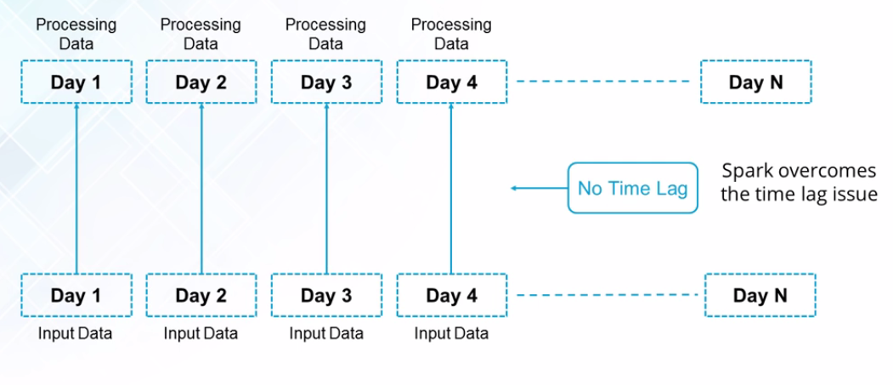
Why Spark ?
Real Time Processing can be done using Spark but not using Hadoop

Slide 28
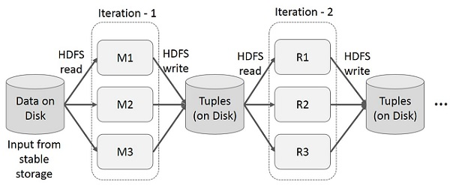
Iterative Operations on MapReduce

Slide 29
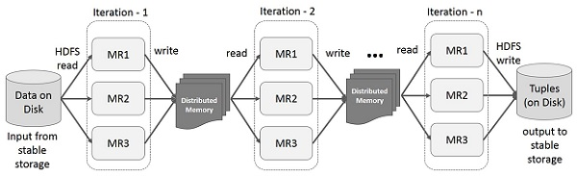
Iterative Operations on Spark

Slide 30
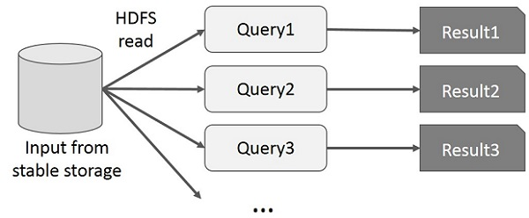
Interactive Operations on MapReduce

Slide 31
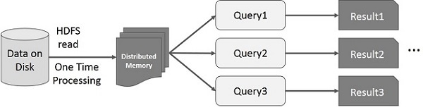
Interactive Operations on Spark

Slide 32
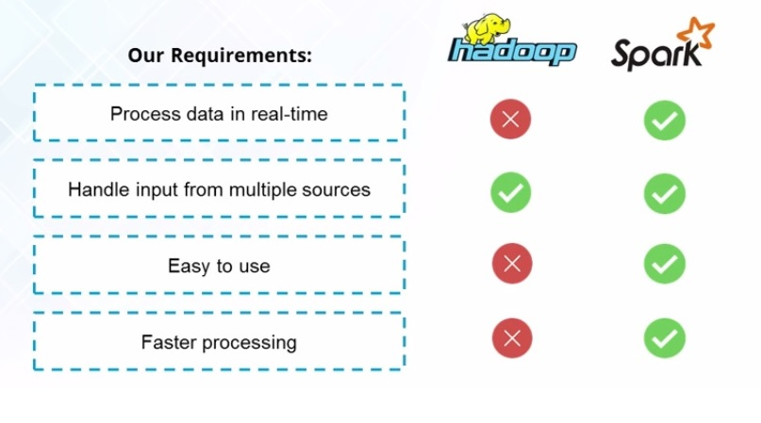
Spark vs Hadoop

Slide 33
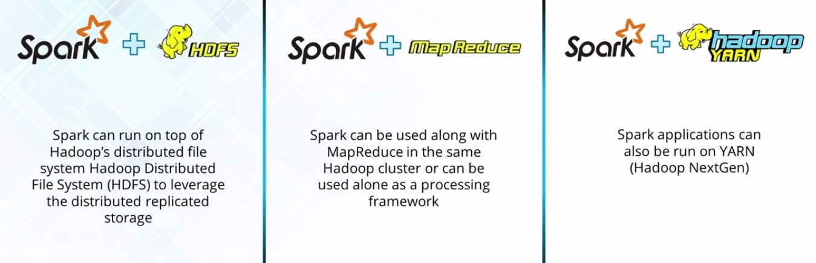
Spark + Hadoop

Slide 34
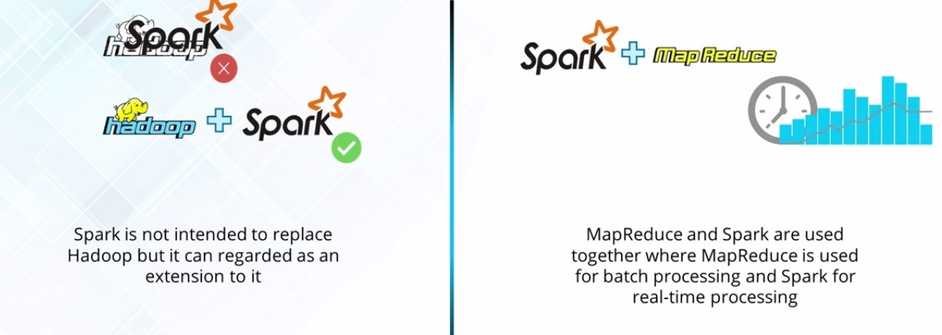
Spark & Hadoop

Slide 35
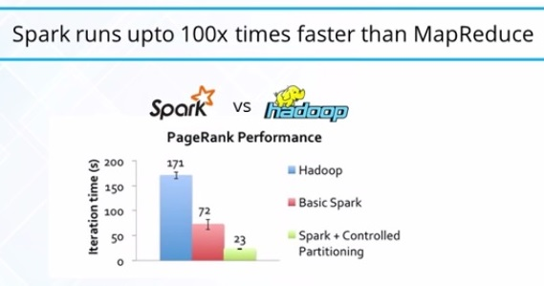
Spark Features
Speed
Polyglot
Advance Analytics
In-Memory Computations
Hadoop Integration
Machine Learning

Slide 36
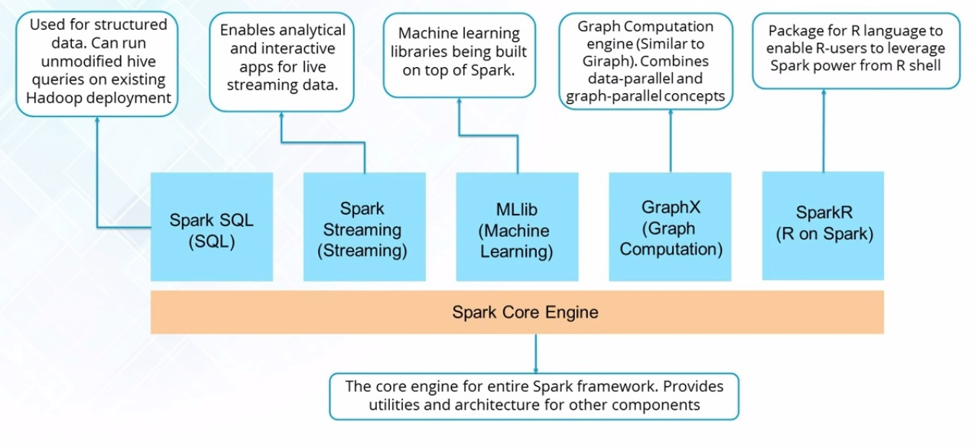
Spark Ecosystem

Slide 37
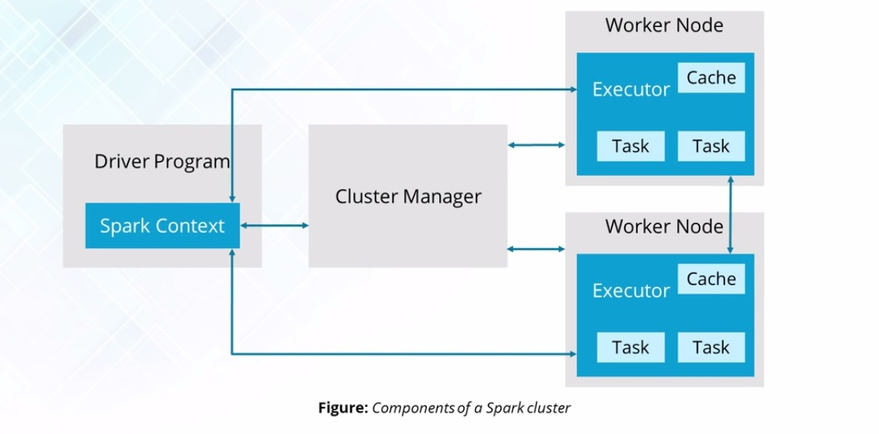
Spark Architecture

Slide 38
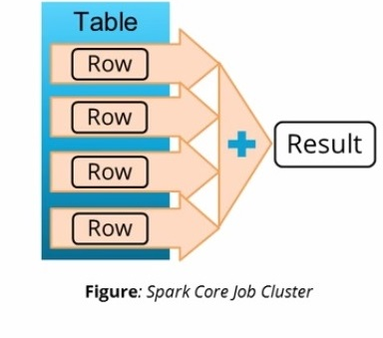
Spark Core
Spark Core is the basic Engine for large-scale Parallel & Distributed data processing
Responsible for
Memory Management
Fault Recovery
Scheduling , Distributing & Monitoring Jobs
Interacting with Storage Systems

Slide 39
Spark Streaming
Spark Streaming is used for Processing Real Time Data
Useful Addition to Core Spark API
Spark Streaming Enables High-Throughput and Fault Tolerant stream processing of live data streams

Slide 40
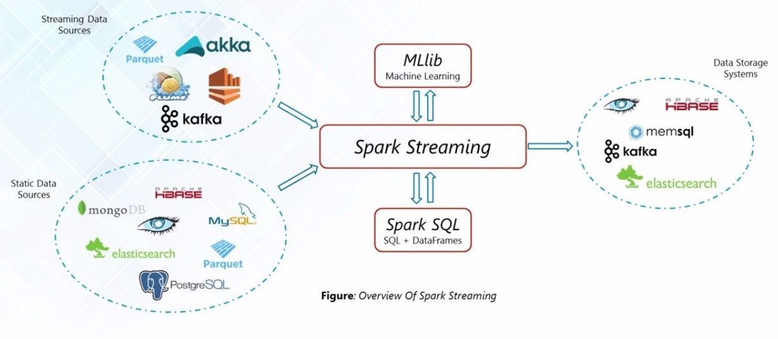
Spark Streaming

Slide 41
For more Information
Spark Tutorials
http://spark-summit.org/2014/training
“Resilient Distributed Datasets: A Fault-Tolerant Abstraction for In-Memory Cluster Computing” by Matei Zaharia et al
https://www.cs.berkeley.edu/~matei/papers/2012/nsdi_spark.pdf

Slide 42
RHADOOP
Dr. Emmanuel S. Pilli
Malaviya NIT Jaipur

Slide 43
The R Language : What is it?
A Language Platform…
A Procedural Language optimized for Statistics and Data Science
A Data Visualization Framework
Provided as Open Source
A Community…
2M Statistical Analysis and Machine Learning Users
Taught in Most University Statistics Programs
Active User Groups Across the World
An Ecosystem...
CRAN: 4500+ Freely Available Algorithms, Test Data, Evaluations
Many Applicable to Big Data If Scaled

Slide 44
Why learn R ?
The R statistical programming language is a free open source package based on the S language developed by Bell Labs.
The style of coding is quite easy.
It’s open source. No need to pay any subscription charges.
Availability of instant access to over 7800 packages customized for various computation tasks.
The community support is overwhelming. There are numerous forums to help you out.
Get high performance computing experience (require packages).
One of highly sought skill by analytics and data science companies.

Slide 45
Innovate with R
Most widely used data analysis software
Used by 2M+ data scientists, statisticians and analysts
Most powerful statistical programming language
Flexible, extensible and comprehensive for productivity
Create beautiful and unique data visualizations
As seen in New York Times, Twitter and Flowing Data
Thriving open-source community
Leading edge of analytics research
Fills the talent gap
New graduates prefer R

Slide 46
R- Operations
R allows performing Data analytics by various operations such as:
Regression
Classification
Clustering
Recommendation
Text mining

Slide 47
Revolution R Enterprise High Performance, Multi-Platform Analytics Platform
Revolution R Enterprise
DeployR
Web Services
Software Development Kit
DevelopR
Integrated Development Environment
Revolution Analytics Value-Add Components
Providing Power and Scale to Open Source R
ConnectR
High Speed & Direct Connectors
Teradata, Hadoop (HDFS, HBase), SAS, SPSS, CSV, OBDC
ScaleR
High Performance Big Data Analytics
Platform LSF, MS HPC Server,
MS Azure Burst, SMP Servers
DistributedR
Distributed Computing Framework
Platform LSF, MS HPC Server, MS Azure Burst
Open Source R
Plus
Revolution Analytics performance enhancements
RevoR
Performance Enhanced Open Source R + CRAN packages
IBM PureData (Netezza), Platform LSF, MS HPC Server, MS Azure Burst, Cloudera, Hortonworks, IBM Big Insights, Intel Hadoop, SMP servers

Slide 48
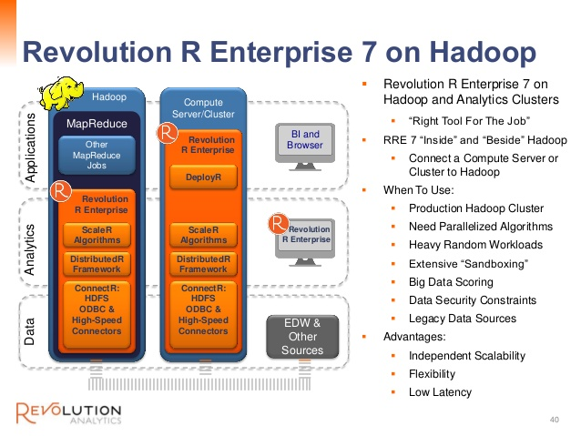

Slide 49
How to link R and Hadoop?
RHadoop was developed by Revolution Analytics
RHadoop is available with three main R packages:
rhdfs - provides HDFS data operations
rmr - provides MapReduce execution operations
rhbase - input data source at the Hbase
Here it’s not necessary to install all of the three RHadoop packages to run the Hadoop MapReduce operations with R and Hadoop.

Slide 50
How to link R and Hadoop?
Learning RHIPE
R and Hadoop Integrated Programming Environment (RHIPE) is a free and open source project. RHIPE is widely used for performing Big Data analysis with D & R analysis.
D & R analysis is used to divide huge data, process it in parallel on a distributed network to produce intermediate output, and finally recombine all this intermediate output into a set.
RHIPE is designed to carry out D & R analysis on complex Big Data in R on the Hadoop platform.
.

Slide 51
How to link R and Hadoop?
Learning Hadoop Streaming
Hadoop streaming is a utility that comes with the Hadoop distribution. This utility allows you to create and run MapReduce jobs with any executable or script as the Mapper and/or Reducer. This is supported by R, Python, Ruby, Bash, Perl, and so on.
There is one R package named HadoopStreaming that has been developed for performing data analysis on Hadoop clusters with the help of R scripts, which is an interface to Hadoop streaming with R.

Slide 52
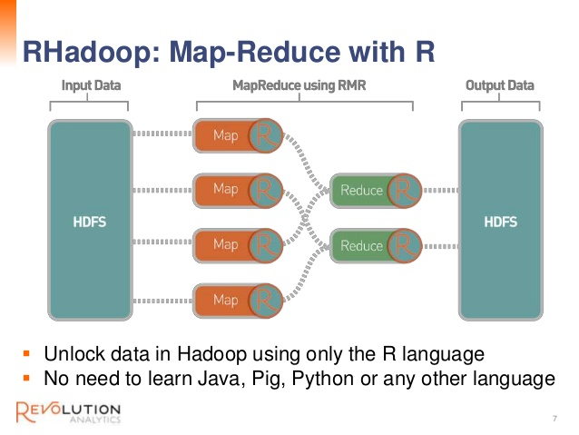

Slide 53
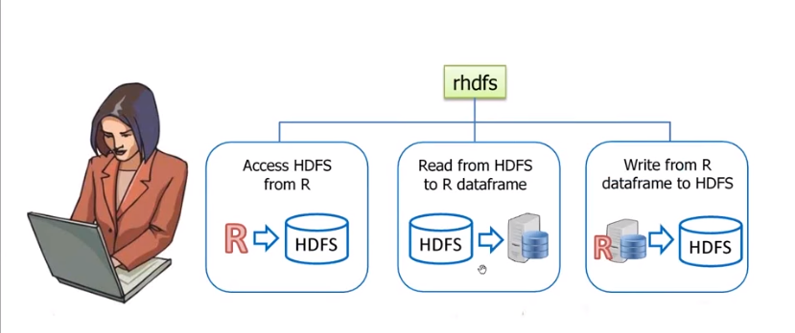
RHDFS

Slide 54
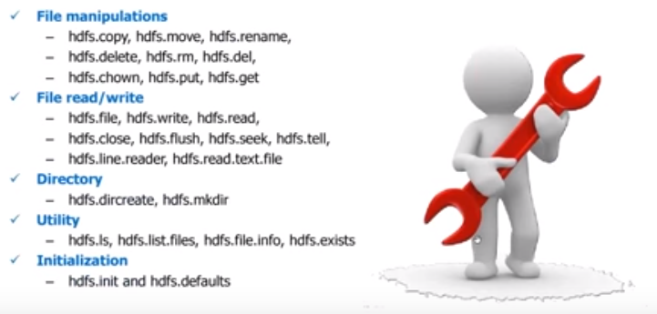
Functionalities in rhdfs

Slide 55
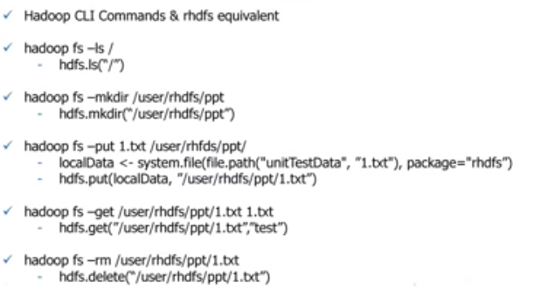
rhdfs

Slide 56
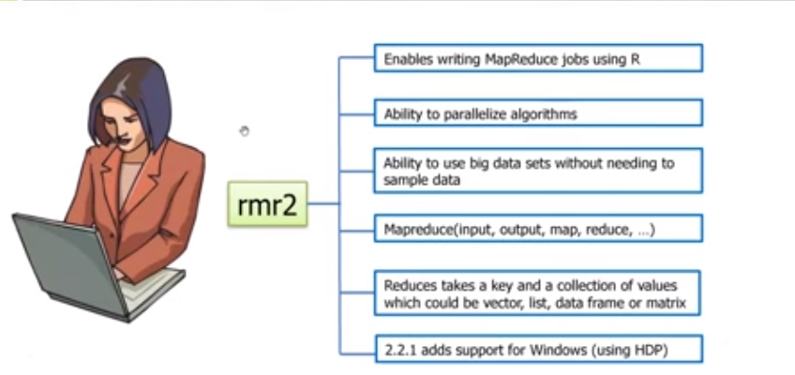
rmr2

Slide 57
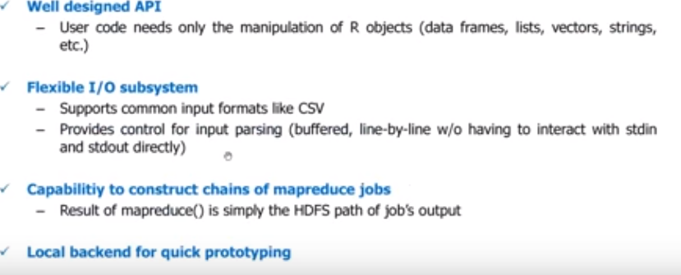
Rmr Advantages

Slide 58
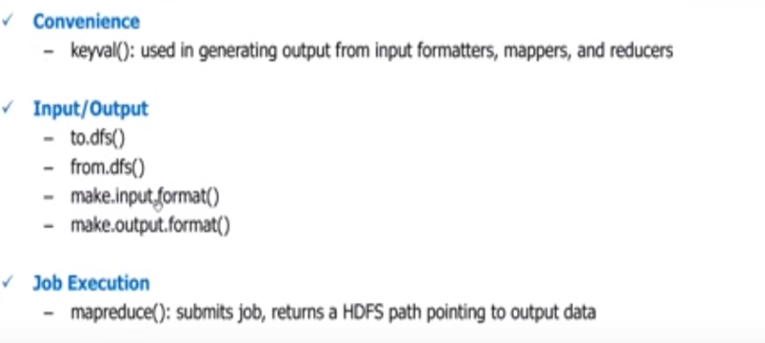
Functionalities in rmr

Slide 59
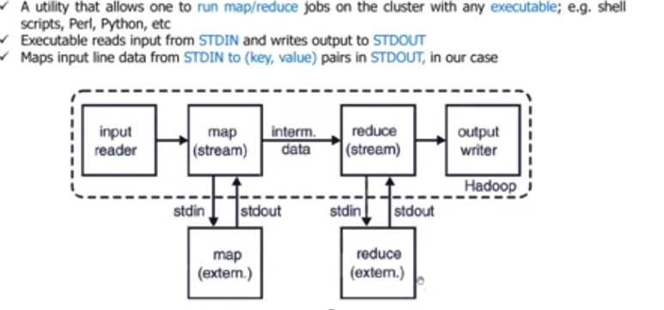
Hadoop Streamming

Slide 60
Summary
R is Hot.
Revolution R Enterprise:
Scales R to Big Data.
Scales Performance on Big Data Platforms
Is Commercially Supported
Is Broadly Deployable
Revolution Analytics Maximizes Results, While Minimizing Near-Term and Long-Term Risks

Slide 61
PIG LATIN
Dr. Emmanuel S. Pilli
Malaviya NIT Jaipur

Slide 62

Agenda
 What is Apache Pig?
 Overview
History
 Architecture
 Installation
 Execution
 Grunt Shell
Operations

Slide 63

What is Apache Pig?
Apache Pig is an abstraction over MapReduce.
Apache Pig is designed to handle any kind of data.
It is a high level extensible language designed to reduce the complexities of coding MapReduce applications.
Pig was developed at Yahoo to help people use Hadoop to emphasize on analyzing large unstructured data sets by minimizing the time spent on writing Mapper and Reducer functions.

Slide 64
Overview
All tasks are encoded in a manner that helps the system to optimize the execution automatically because typically 10 lines of code in Pig equal 200 lines of code in Java.
Pig converts its operators into MapReduce code. It allows us to concentrate upon the whole operation irrespective of the individual mapper and reducer functions.
Apache Pig is composed of 2 components mainly: one is the Pig Latin programming language and the other is the Pig Runtime environment in which Pig Latin programs are executed.

Slide 65
Overview
Pig is generally used with Hadoop; we can perform all the data manipulation operations in Hadoop using Pig.
It is similar to SQL query language but applied on a larger dataset and with additional features.
The language used in Pig is called PigLatin. It is very similar to SQL.
It is used to load the data, apply the required filters and dump the data in the required format.
It requires a Java runtime environment to execute the programs.

Slide 66

Where to use Pig?
It is ideal for ETL operations i.e; Extract, Transform and Load.
It allows a detailed step by step procedure by which the data has to be transformed. It can handle inconsistent schema data.
Pig is intended to handle all kinds of data, including structured and unstructured information and relational and nested data.

Slide 67
Apache Pig v/s MapReduce
Pig | MapReduce
Apache Pig is a data flow language. | MapReduce is a data processing paradigm.
Easy to perform Join operation. | Difficult to perform Join operation.
Uses multi-query approach, thereby reducing the length of the codes to a great extent. | Requires almost 20 times more the number of lines to perform the same task.
No need for compilation. On execution, every Pig operator is converted internally into a MapReduce job. | MapReduce jobs have a long compilation process.

Slide 68
History
In 2006, Apache Pig was developed as a research project at Yahoo, especially to create and execute MapReduce jobs on every dataset.
In 2007, Apache Pig was open sourced via Apache incubator.
In 2008, the first release of Apache Pig came out.
In 2010, Apache Pig graduated as an Apache top-level project.

Slide 69
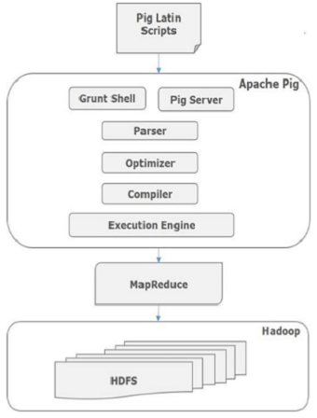
Architecture

Slide 70
Architectural Components
Parser
Initially the Pig Scripts are handled by the Parser. It checks the syntax of the script, does type checking, and other miscellaneous checks.
The output of the parser will be a DAG (directed acyclic graph), which represents the Pig Latin statements and logical operators.
In the DAG, the logical operators of the script are represented as the nodes and the data flows are represented as edges.

Slide 71
Architectural Components
Optimizer
The logical plan (DAG) is passed to the logical optimizer, which carries out the logical optimizations such as projection and pushdown.
Compiler
The compiler compiles the optimized logical plan into a series of MapReduce jobs.
Execution engine
Finally, the MapReduce jobs are submitted to Hadoop in a sorted order. Finally, these MapReduce jobs are executed on Hadoop producing the desired results.

Slide 72
Installation
Prerequisites
It is essential that you have Hadoop and Java installed on your system before you go for Apache Pig. Therefore, prior to installing Apache Pig, install Hadoop and Java
Steps
First of all, download the latest version of Apache Pig from the following website − https://pig.apache.org/
Open the homepage of Apache Pig website. Under the section News, click on the link release page
On clicking the specified link, you will be redirected to the Apache Pig Releases page.
Click on the link under the Download option i.e. Download a release now!

Slide 73

Open this mirror site for downloading the latest version of Pig http://www-eu.apache.org/dist/pig
The Pig Releases page shown below contains various versions of Apache Pig. Click the latest version among them.

Slide 74
Within these folders, you will have the source and binary files of Apache Pig in various distributions.
Download the tar files of the source and binary files of Apache Pig 0.17, pig0.17.0-src.tar.gz and pig-0.17.0.tar.gz.
Note : After downloading the Apache Pig software, install it in your Linux environment by following the steps given below.
Step 1
Create a directory with the name Pig in the same directory where the installation directories of Hadoop were installed.
$ mkdir Pig
Step 2
Extract the downloaded tar files as shown below.
$ cd Downloads/
$ tar zxvf pig-0.17.0-src.tar.gz
$ tar zxvf pig-0.17.0.tar.gz

Slide 75
Step 3
Move the content of pig-0.17.0-src.tar.gz file to the Pig directory created earlier as shown below.
$ mv pig-0.17.0-src.tar.gz/* /home/Hadoop/Pig/
Step 4
After installing Apache Pig, we have to configure it. To configure, we need to edit file − bashrc. In the .bashrc file, set the following variables −
export PIG_HOME = /home/Hadoop/Pig
export PATH = $PATH:/home/Hadoop/Pig/bin
export PIG_CLASSPATH = $HADOOP_HOME/conf
Note:-
PIG_HOME folder to the Apache Pig’s installation folder,
PATH environment variable to the bin folder, and
PIG_CLASSPATH environment variable to the etc (configuration) folder of your Hadoop installations (the directory that contains the core-site.xml, hdfs-site.xml and mapred-site.xml files).

Slide 76
Verifying the Installation
Verify the installation of Apache Pig by typing the version command. If the installation is successful, you will get the version of Apache Pig as shown below.
$ pig –version
Apache Pig version 0.17.0
compiled Jun 01 2017, 11:44:35

Slide 77
Execution
Apache Pig Execution Modes
You can run Apache Pig in two modes, namely, Local Mode and HDFS mode.
Local Mode
In this mode, all the files are installed and run from your local host and local file system. There is no need of Hadoop or HDFS. This mode is generally used for testing purpose.
MapReduce Mode
MapReduce mode is where we load or process the data that exists in the Hadoop File System (HDFS) using Apache Pig. In this mode, whenever we execute the Pig Latin statements to process the data, a MapReduce job is invoked in the back-end to perform a particular operation on the data that exists in the HDFS.

Slide 78
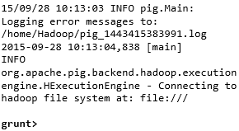
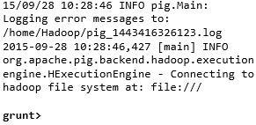
Grunt Shell
You can invoke the Grunt shell in a desired mode (local/MapReduce) using the −x option as shown below.
Local mode MapReduce mode
Command − $ ./pig –x local Command − $ ./pig -x mapreduce
Output − Output −

Slide 79
Either of these commands in the previous slide gives you the Grunt shell prompt as shown below.
grunt>
You can exit the Grunt shell using ‘ctrl + d’.
After invoking the Grunt shell, you can execute a Pig script by directly entering the Pig Latin statements in it. Example,
grunt> customers = LOAD 'customers.txt' USING PigStorage(',');
Executing Apache Pig in Batch Mode
You can write an entire Pig Latin script in a file and execute it using the –x command. Let us suppose we have a Pig script in a file named sample_script.pig as shown below.

Slide 80
Sample_script.pig
student = LOAD 'hdfs://localhost:9000/pig_data/student.txt' USING PigStorage(',') as (id:int,name:chararray,city:chararray); Dump student;
Now, you can execute the script in the above file as shown below.
Local mode: $ pig -x local Sample_script.pig
MapReduce mode: $ pig -x mapreduce Sample_script.pig

